Slide 1

Chapter 11
Positive Institutions and Cultural Well-Being

Slide 2
Employee Engagement and Job Satisfaction
Definition of employee engagement
Positive, work-related state of mind, dedication, and absorption
Characterized by energy, involvement, and efficacy (which is opposite of job burnout elements of exhaustion, cynicism, inefficacy)
Differs from job satisfaction…both involve positive focus, but engagement goes beyond with involvement, absorption, dedication

Slide 3
Employee Engagement and Job Satisfaction
What promotes employee engagement?
Positive emotions and work
Positive emotionality disposition
High…more enthusiastic, energetic, excited about job, report higher JS
Zest, or approach life with anticipation, energy, excitement, a form of positive emotionality, predicts seeing work as calling and JS
Notes:
Contributes to positive spontaneous behavior: Such people are more likely to be helpful to others, develop skills that aid the organization, make constructive rather than destructive criticisms, spread goodwill, and take actions that help protect the organization from threats and dangers.
Enhances workplace achievement: People who possess higher confidence, optimism, self-efficacy, likability, and sociability have a definite advantage when launching their careers--and are more likely to advance than their less happy peers.
Explanations for the outcomes of positive emotions: Positive emotions are associated with approach-oriented behavior. Happy workers tend to be more engaged with their jobs. They are more popular and gain greater social support from both colleagues and supervisors. Better “team players” and are valued more by coworkers.

Slide 4
Employee Engagement and Job Satisfaction
What promotes employee engagement?
Positive emotions and work
Helps enhance problem-solving and decision-making…flexible, creative, innovative problem solving
Contributes to positive spontaneous behavior
Think Fredrickson’s Broaden and Build Theory
Enhances workplace achievement
Positive moods…more sociable, less aggressive
More likely to engage in OCBs
Notes:
Contributes to positive spontaneous behavior: Such people are more likely to be helpful to others, develop skills that aid the organization, make constructive rather than destructive criticisms, spread goodwill, and take actions that help protect the organization from threats and dangers.
Enhances workplace achievement: People who possess higher confidence, optimism, self-efficacy, likability, and sociability have a definite advantage when launching their careers--and are more likely to advance than their less happy peers.
Explanations for the outcomes of positive emotions: Positive emotions are associated with approach-oriented behavior. Happy workers tend to be more engaged with their jobs. They are more popular and gain greater social support from both colleagues and supervisors. Better “team players” and are valued more by coworkers.

Slide 5
Employee Engagement and Job Satisfaction
What promotes employee engagement?
Positive emotions and work
Happiness Advantage
Happiness—vocational success link
Some researchers suggest positive emotionality precedes and enhances workplace achievement
Higher confidence, optimism, self-efficacy, likability, sociability are advantageous
Notes:
Contributes to positive spontaneous behavior: Such people are more likely to be helpful to others, develop skills that aid the organization, make constructive rather than destructive criticisms, spread goodwill, and take actions that help protect the organization from threats and dangers.
Enhances workplace achievement: People who possess higher confidence, optimism, self-efficacy, likability, and sociability have a definite advantage when launching their careers--and are more likely to advance than their less happy peers.
Explanations for the outcomes of positive emotions: Positive emotions are associated with approach-oriented behavior. Happy workers tend to be more engaged with their jobs. They are more popular and gain greater social support from both colleagues and supervisors. Better “team players” and are valued more by coworkers.

Slide 6
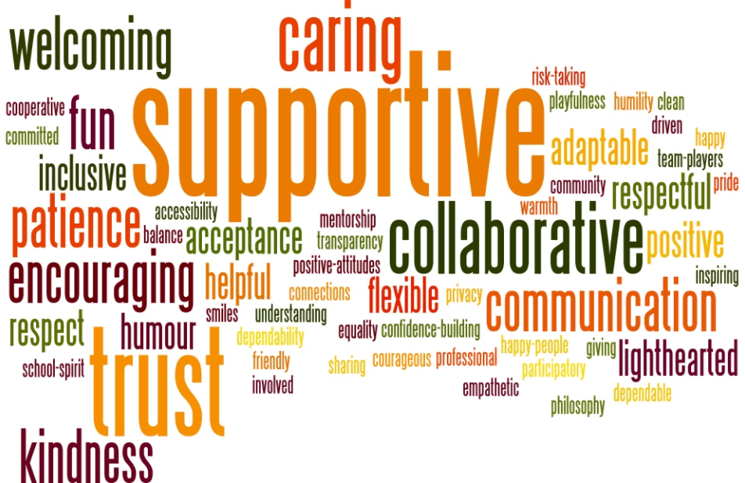
Employee Engagement and Job Satisfaction
Positive emotions and work
Explanations
Positive emotions linked with approach-oriented behaviors
More likely to enter novel situations, interact with others, pursue new goals
More engaged with work
Less burnout, less emotional exhaustion, less absenteeism, less turnover
More popular, gain more social support
Engage in more helpful behavior
Notes:
Contributes to positive spontaneous behavior: Such people are more likely to be helpful to others, develop skills that aid the organization, make constructive rather than destructive criticisms, spread goodwill, and take actions that help protect the organization from threats and dangers.
Enhances workplace achievement: People who possess higher confidence, optimism, self-efficacy, likability, and sociability have a definite advantage when launching their careers--and are more likely to advance than their less happy peers.
Explanations for the outcomes of positive emotions: Positive emotions are associated with approach-oriented behavior. Happy workers tend to be more engaged with their jobs. They are more popular and gain greater social support from both colleagues and supervisors. Better “team players” and are valued more by coworkers.

Slide 7
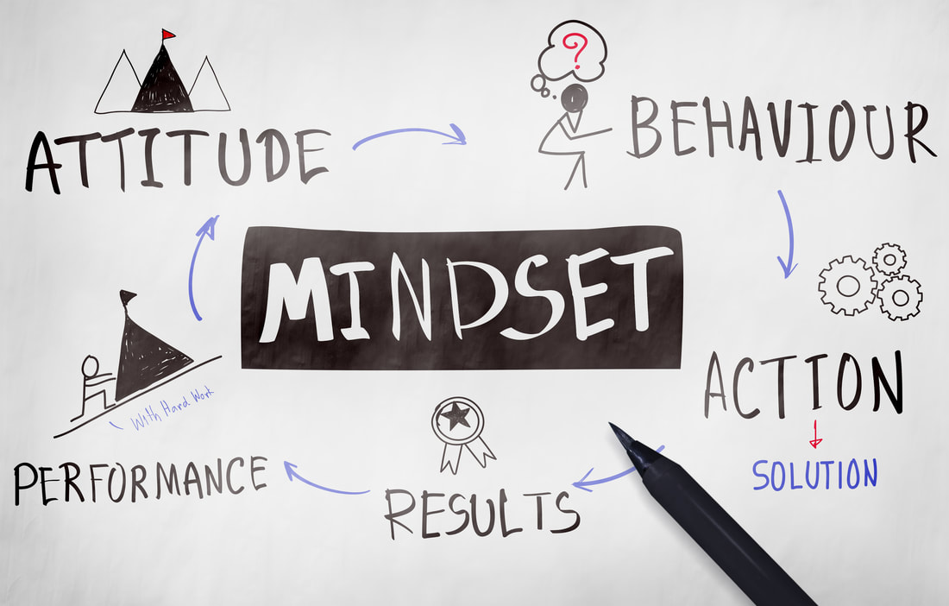
Employee Engagement and Job Satisfaction
Positive emotions and work
Psychological Capital: combination of:
Self-efficacy
Hope
Optimism
Resiliency
Notes:
Contributes to positive spontaneous behavior: Such people are more likely to be helpful to others, develop skills that aid the organization, make constructive rather than destructive criticisms, spread goodwill, and take actions that help protect the organization from threats and dangers.
Enhances workplace achievement: People who possess higher confidence, optimism, self-efficacy, likability, and sociability have a definite advantage when launching their careers--and are more likely to advance than their less happy peers.
Explanations for the outcomes of positive emotions: Positive emotions are associated with approach-oriented behavior. Happy workers tend to be more engaged with their jobs. They are more popular and gain greater social support from both colleagues and supervisors. Better “team players” and are valued more by coworkers.

Slide 8
Employee Engagement and Job Satisfaction
What promotes employee engagement?
More frequent positive emotions or more intense emotions?
Frequency of positive emotions more important than the intensity, because bursts (e.g., motivational seminar) are short lived, so need more frequent
Create work environments that induce positive emotions more consistently
Notes:
Frequency of positive emotions important than the intensity: For example, many employees gain a huge burst of self-confidence, enthusiasm, and camaraderie after attending motivational seminars, workshops, and personal tests of courage such as outdoor adventure experiences.

Slide 9

Employee Engagement and Job Satisfaction
What promotes employee engagement?
It’s not just a job, it’s a calling
Three views of occupation (Wrzesniewski and colleagues)
Job
Work is necessary to earn a living
Career
Jobs facilitate achievement motivation, stimulate need for competition, enhance prestige
Calling
Job is source of personal fulfilment
See job as having a socially useful purpose
Notes:
Three views of occupation and explanation: Job, calling, career. Job focuses on the financial gains from work and on the necessity of work and earning a living. Career is a way to facilitate achievement motivation, stimulate their need for competition, or enhance prestige and satisfaction. Calling is a source of personal fulfillment; for many, this sense of fulfillment and meaning came from recognizing or simply believing that what they did had a socially useful purpose.
Features of calling:
Action-orientation, that is, an emphasis on doing rather than simply being. Specifically, a calling refers to a course of action, an activity to be done.
Sense of clarity of purpose, direction, meaning, and personal mission.
Prosocial intention, that is, a desire to make the world a better place.
People who regard their work as calling reap benefits: More focused career decision-making, higher motivation, increased job satisfaction, lower stress and frustration, stronger organizational commitment, and better organizational citizenship behavior.

Slide 10
Employee Engagement and Job Satisfaction
What promotes employee engagement?
It’s not just a job, it’s a calling
Calling…related to individual success, resilience, and job satisfaction
Features of calling
Action orientation (emphasis on doing)
Clarity of purpose, direction, meaning, personal mission
Prosocial intention (desire to make world a better place)
Notes:
Three views of occupation and explanation: Job, calling, career. Job focuses on the financial gains from work and on the necessity of work and earning a living. Career is a way to facilitate achievement motivation, stimulate their need for competition, or enhance prestige and satisfaction. Calling is a source of personal fulfillment; for many, this sense of fulfillment and meaning came from recognizing or simply believing that what they did had a socially useful purpose.
Features of calling:
Action-orientation, that is, an emphasis on doing rather than simply being. Specifically, a calling refers to a course of action, an activity to be done.
Sense of clarity of purpose, direction, meaning, and personal mission.
Prosocial intention, that is, a desire to make the world a better place.
People who regard their work as calling reap benefits: More focused career decision-making, higher motivation, increased job satisfaction, lower stress and frustration, stronger organizational commitment, and better organizational citizenship behavior.

Slide 11
Employee Engagement and Job Satisfaction
What promotes employee engagement?
It’s not just a job, it’s a calling
People who regard their work as calling reap benefits
Focused career decision making
Higher motivation
Increased job satisfaction
Lower stress and frustration
Stronger organizational commitment
Better organizational citizenship behavior
Potential Downside: challenge to balance passion for work with family, social, and leisure activities
Notes:
Three views of occupation and explanation: Job, calling, career. Job focuses on the financial gains from work and on the necessity of work and earning a living. Career is a way to facilitate achievement motivation, stimulate their need for competition, or enhance prestige and satisfaction. Calling is a source of personal fulfillment; for many, this sense of fulfillment and meaning came from recognizing or simply believing that what they did had a socially useful purpose.
Features of calling:
Action-orientation, that is, an emphasis on doing rather than simply being. Specifically, a calling refers to a course of action, an activity to be done.
Sense of clarity of purpose, direction, meaning, and personal mission.
Prosocial intention, that is, a desire to make the world a better place.
People who regard their work as calling reap benefits: More focused career decision-making, higher motivation, increased job satisfaction, lower stress and frustration, stronger organizational commitment, and better organizational citizenship behavior.

Slide 12
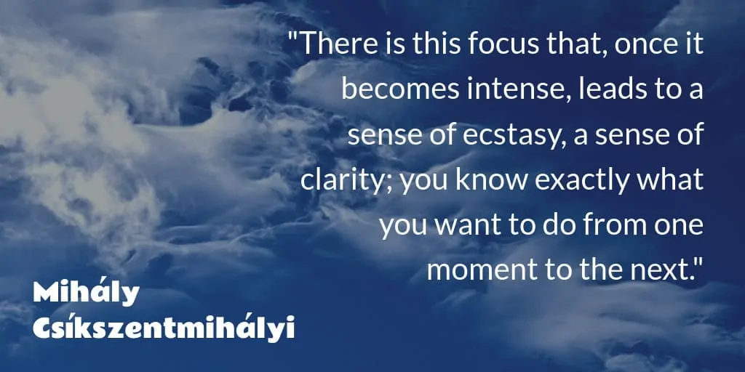
Employee Engagement and Job Satisfaction
What promotes employee engagement?
Being in flow at work
People who enjoy their jobs report being in a state of flow during work
Recall: high skills match high challenge
More flow experiences is the key to job satisfaction
Notes:
Five core elements that influence workers’ attitudes and behavior:
Skill variety.
Task identity.
Task significance.
Autonomy.
Feedback.

Slide 13
Employee Engagement and Job Satisfaction
What promotes employee engagement?
Being in flow at work
Job Characteristics Model: Five core elements that influence workers’ attitudes and behavior
Skill variety
Task identity
Task significance
Autonomy
Feedback
May be aspects of work that are instrumental in being able to find flow at work
Notes:
Five core elements that influence workers’ attitudes and behavior:
Skill variety.
Task identity.
Task significance.
Autonomy.
Feedback.

Slide 14
Employee Engagement and Job Satisfaction
Strengths-based approach to engagement
Myths of career satisfaction and success
Gallup and personal strengths, talents
Traits, abilities, interests, skills that show us at our best and make us unique
Identified myths that inhibit us
Myth 1: Fixing weakness better than fostering and building strength
Myth 2: People can do anything they put their minds to
Better to know your limitations and work with them

Slide 15
Employee Engagement and Job Satisfaction
Strengths-based approach to engagement
Focus on your strengths
Examine strength and work upon it
Weaknesses should be recognized and managed
Focus on one strength and as it develops, other strengths rise in salience

Slide 16
Employee Engagement and Job Satisfaction
Strengths-based approach to engagement:
Recognize your strengths
Strength has five characteristics
Yearnings
Utilize strength…feel intrinsic satisfaction
Learning comes easier
Extraordinary performance…maybe even flow
Performance seems to take less effort
Notes:
Yearnings: Strong psychological pulls one feels toward certain interests, goals, or directions. They comprise the internal compass that can point out our direction if attention is paid to.
Utilize strength for intrinsic satisfaction: When one utilizes his or her strength and accomplishes a task, one feels good about oneself and about the activity.
Learning comes easier: Utilizing strength in some areas helps absorb information and makes learning easier.
Extraordinary performance: Activating a strength helps perform extraordinarily well.

Slide 17
Employee Engagement and Job Satisfaction
Strengths-based approach to engagement
The development of strengths
Strengths develop best in relation to other persons
Interpersonal support, understanding, empathy, and commitment to relationships help strengths grow
Strengths develop best when we have deep commitment for future or even a life passion
Notes:
Strengths develop best in relation to other persons: Interpersonal support, understanding, empathy, and commitment to relationships help create the crucible in which strengths can grow. Strengths develop when we place positive expectations on others and ourselves.

Slide 18
Employee Engagement and Job Satisfaction
Strengths-based approach to engagement
Appreciative Inquiry
Opposite of problem-solving, which is focus on what’s wrong, to focus on what works in org and strengths already present
Works on strengths, focuses on positive development
Notes:
AI 4-D cycle used to move to positive solution: The process begins when an “affirmative topic” or “positive core” has been identified. This topic puts the focus not on the “problem” but on the positive future to be created. The first stage is “Discover” or finding what already works well. The second stage is “Dream” or envisioning the positive future. Stages 3 and 4 are “Design” or planning the processes that will work and “Destiny” or implementing the design. The AI model is often combined with the SOAR model (Strengths, Opportunities, Aspirations, and Results) to facilitate lasting organizational changes.

Slide 19
Employee Engagement and Job Satisfaction
Strengths-based approach to engagement
Appreciative Inquiry
AI 4-D cycle used to move to positive solution by first identifying “affirmative topic” or “positive core”
Discover what works well already
Dream, envision positive future
Design, planning the processes that will work
Destiny, implementing the design
Notes:
AI 4-D cycle used to move to positive solution: The process begins when an “affirmative topic” or “positive core” has been identified. This topic puts the focus not on the “problem” but on the positive future to be created. The first stage is “Discover” or finding what already works well. The second stage is “Dream” or envisioning the positive future. Stages 3 and 4 are “Design” or planning the processes that will work and “Destiny” or implementing the design. The AI model is often combined with the SOAR model (Strengths, Opportunities, Aspirations, and Results) to facilitate lasting organizational changes.

Slide 20
Employee Engagement and Job Satisfaction
Employee engagement: A positive work environment
Job characteristics and well-being
Job Characteristics Model
Recall skill variety, task identity, task significance, autonomy, feedback
Important for job satisfaction
Factors of work environment
Notes:
Factors of work environment: Multiple social relationships, the amount of time that one is expected to put into the job, the type of organizational structure, the opportunities for advancement or recognition, the ability to use one’s skills and learn new skills, and numerous elements that surround the issue of salary and compensation.

Slide 21
Employee Engagement and Job Satisfaction
10 Elements of Well-Being
Opportunity for personal control
Opportunity for skill use
Reasonable externally generated goals
Variety
Environmental clarity
Availability of money
Physical security
Supportive supervision
Opportunity for interpersonal contact
Work is valued by society
Notes:
Ten major elements of the work environment that determine well-being at work:
Opportunity for personal control.
Opportunity for skill use.
Reasonable externally generated goals.
Variety.
Environmental clarity.
Availability of money.
Physical security.
Supportive supervision.
Opportunity for interpersonal contact.
Work valued by society.

Slide 22
Employee Engagement and Job Satisfaction
Leadership
Key factor for fostering engaged employees and flourishing organizations
Great Person theories: Heroic individuals successfully motivate others; “leaders are born, not made”
Transformational leadership approach
Transformational leaders increase self-confidence, intrinsic motivation, and self-expectation among group leaders
Notes:
Transformational leadership approach: A transformational leader unleashes the power and harnesses the talent within a group to help it be successful.
Traits of able leadership:
Possessing a broad vision.
Having optimism and excitement about the future.
Valuing individuals for their unique talents and seeking to maximize their self-actualization.
Dedication and hard work.
Integrity.
Providing clear directives and specific feedback.
Leadership theories: Leadership theories are more and more acknowledging the complex process that leadership actually is. They have moved away from a strong focus on transformational leadership toward a greater emphasis on shared and relational factors, especially the interaction between leader and follower.

Slide 23
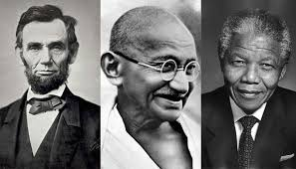
Employee Engagement and Job Satisfaction
Transformational Leadership
How are transformational leaders effective?
Leaders posses a vision that is discrepant from the status quo, resonates with followers
Leaders have optimism and excitement about future
Leaders value individuals for unique talents and seek to maximize their self-actualization
High in dedication and hard work
High integrity
Provide clear directives and specific feedback
Possess charisma
Notes:
Transformational leadership approach: A transformational leader unleashes the power and harnesses the talent within a group to help it be successful.
Traits of able leadership:
Possessing a broad vision.
Having optimism and excitement about the future.
Valuing individuals for their unique talents and seeking to maximize their self-actualization.
Dedication and hard work.
Integrity.
Providing clear directives and specific feedback.
Leadership theories: Leadership theories are more and more acknowledging the complex process that leadership actually is. They have moved away from a strong focus on transformational leadership toward a greater emphasis on shared and relational factors, especially the interaction between leader and follower.

Slide 24
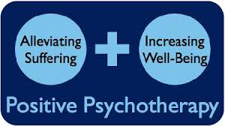

Careers That Use Positive Psychology

Slide 25
Careers That Use Positive Psychology
Positive Psychotherapy
Focus on enhancing of positive traits, building strengths, helping clients find untapped resources for positive change
Solution-focused therapy
Help clients find strengths
Set realistic goals for newer healthy behaviors
Well-being therapy
Help clients restructure the way they think about aspects of their lives
Notes:
Solution-focused therapy: Therapists help their clients find what strengths they have utilized in the past, remember how they have solved problems similar to the present one, and set realistic goals for newer healthy behaviors.
Well-being therapy: This helps clients to restructure the way they think about aspects of their lives related to Ryff’s six dimensions of psychological well-being.
Acceptance and commitment therapy: ACT teaches people how to actively accept and embrace all their experiences with mindful awareness and with equanimity, to commit to building their best life, and to operate from their core values.

Slide 26
Careers That Use Positive Psychology
Positive Psychotherapy
Acceptance and commitment therapy ACT
Teaches how to actively accept and embrace experiences with mindful awareness and equanimity, to commit to building best life, and to operate from their core values
Notes:
Solution-focused therapy: Therapists help their clients find what strengths they have utilized in the past, remember how they have solved problems similar to the present one, and set realistic goals for newer healthy behaviors.
Well-being therapy: This helps clients to restructure the way they think about aspects of their lives related to Ryff’s six dimensions of psychological well-being.
Acceptance and commitment therapy: ACT teaches people how to actively accept and embrace all their experiences with mindful awareness and with equanimity, to commit to building their best life, and to operate from their core values.

Slide 27
Careers That Use Positive Psychology
Positive psychotherapy: Positive clinical psychology
Focusing on strengths and competencies as foundation for psychotherapy work
Strengths of all effective therapy: instill hope
Additionally: instill courage, insight, optimism, authenticity, perseverance, and ability to dispute one’s own negative thinking
Such interventions increase well-being, decrease symptoms of depression

Slide 28
Careers That Use Positive Psychology
Positive psychotherapy: Life coaching
Consultant to help attain goals
Help reach a major decision, mark a new direction, find better way to personal fulfillment
No consistent standards for certification or training

Slide 29
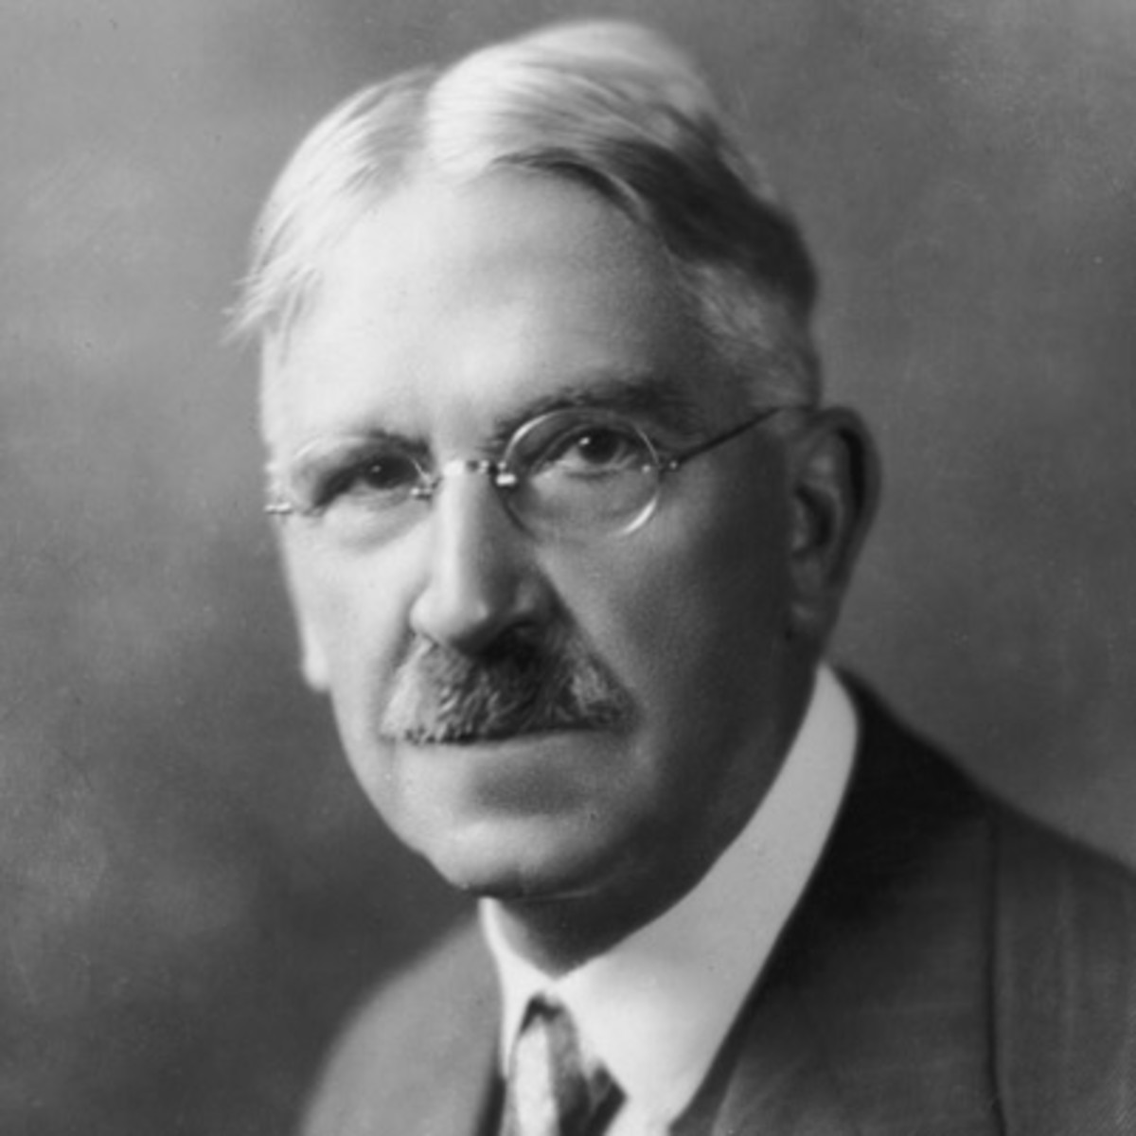
Careers That Use Positive Psychology
Positive Psychology in Schools
John Dewey
Argued schools should be places that foster a desire to learn, expand one’s potentials, and instill a desire to live and work cooperatively with others
Dewey’s ideas + PosPsyc IPEN
International Positive Education Network
Goals of IPEN
Notes:
Dewey and International Positive Education Network: Dewey argued that most schools failed to foster exploration, a sense of discovery, or the development of sound judgment skills. He contended that schools should be environments that fostered a desire to learn, to expand one’s potentials, and instill a desire to live and work cooperatively with others. These ideas combined with positive psychology to help create the International Positive Education Network.
Goals of IPEN: Fulfillment of the intellectual potential of all students, the development of character strengths, and to support collaboration and change government education policy.
Traits of positive education: Promote the well-being of students as a central goal, focus on developing personal strengths and competencies, giving students opportunities to be fully engaged in activities and in active learning, be caring communities that were built around cooperative relationships between students, faculty, and peers, promote the ability to be resilient and bounce back from challenges that are typical of school life and also promote peak-experiences.
The Positive Behavior Support: PBS initiative provides help for at-risk students and operates from William Glasser’s Reality Therapy. PBS encourages social competence, responsibility, positive communication, and self-management skills while taking a positive approach, rather than a punitive one, to difficult student behavior.

Slide 30

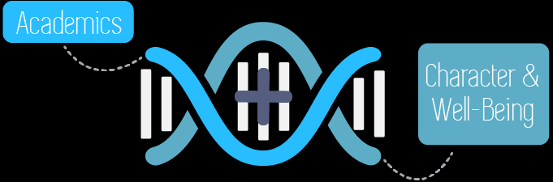
Careers That Use Positive Psychology
Positive Psychology in Schools
Goals of IPEN
Fulfill intellectual potential of students
Develop character strengths
Support collaboration
Change government education policy
Notes:
Dewey and International Positive Education Network: Dewey argued that most schools failed to foster exploration, a sense of discovery, or the development of sound judgment skills. He contended that schools should be environments that fostered a desire to learn, to expand one’s potentials, and instill a desire to live and work cooperatively with others. These ideas combined with positive psychology to help create the International Positive Education Network.
Goals of IPEN: Fulfillment of the intellectual potential of all students, the development of character strengths, and to support collaboration and change government education policy.
Traits of positive education: Promote the well-being of students as a central goal, focus on developing personal strengths and competencies, giving students opportunities to be fully engaged in activities and in active learning, be caring communities that were built around cooperative relationships between students, faculty, and peers, promote the ability to be resilient and bounce back from challenges that are typical of school life and also promote peak-experiences.
The Positive Behavior Support: PBS initiative provides help for at-risk students and operates from William Glasser’s Reality Therapy. PBS encourages social competence, responsibility, positive communication, and self-management skills while taking a positive approach, rather than a punitive one, to difficult student behavior.

Slide 31
Careers That Use Positive Psychology
Social entrepreneurs
Create solutions that have social value
Socially responsible
Encourage social transformation
Qualities of social entrepreneurs
Empathy
Elevated sense of moral judgment

Slide 32
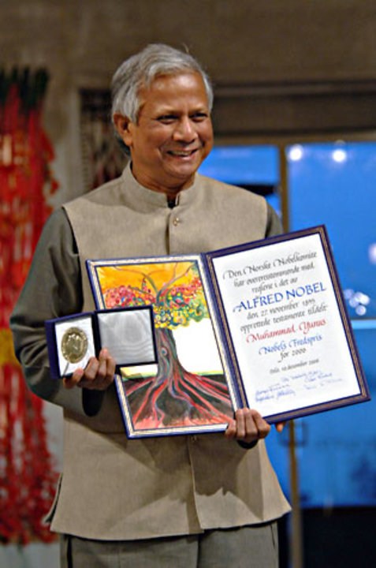
Muhammad Yunus, Social Entrepreneur
Muhammad Yunus is a Bangladesh social entrepreneur, banker, economist, and civil society leader who was awarded the Nobel Peace Prize for founding the Grameen Bank and pioneering the concepts of microcredit and microfinance. These loans are given to entrepreneurs too poor to qualify for traditional bank loans

Slide 33
Careers That Use Positive Psychology
Academic programs in positive psychology
Positive psychology blended into programs:
Psychology
Teaching, business, or law
Masters in Applied Positive Psychology (MAPP) program
PhD programs in positive developmental and positive organizational psychology

Slide 34
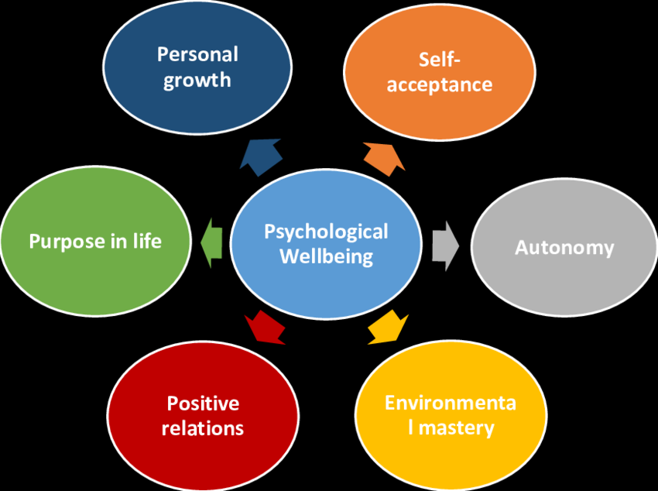
Positive Communities
Complete Mental Health Classification should include:
Emotional well-being (subjective WB)
Psychological well-being
Social well-being
Notes:
Comprises of five dimensions: Social acceptance, Social actualization, Social contribution, Social coherence, Social integration.
Positive correlation with elements: Measures of happiness, life satisfaction, generativity, optimism, perceptions of neighborhood trust and safety, and subjective perceptions of one’s physical health and degree of community involvement.
Distinct way of judging our own sense of well-being: Since it is similar to other measures of mental health. Is also important for overall mental health and well-being.

Slide 35
Positive Communities
5 Dimensions of Social well-being
Social acceptance
Positive attitudes toward others
Social actualization
Believing society has capability of developing and evolving into a better place
Social contribution
Belief daily activities contributes and is valued by community
Social coherence
Degree to which society seems to be understandable, predicable, and logical
Social integration
Degree to which feel part of community and how much support and commonality one feels toward others
Notes:
Comprises of five dimensions: Social acceptance, Social actualization, Social contribution, Social coherence, Social integration.
Positive correlation with elements: Measures of happiness, life satisfaction, generativity, optimism, perceptions of neighborhood trust and safety, and subjective perceptions of one’s physical health and degree of community involvement.
Distinct way of judging our own sense of well-being: Since it is similar to other measures of mental health. Is also important for overall mental health and well-being.

Slide 36
Positive Communities
Social well-being
Positive correlation with measures of happiness, life satisfaction, generativity, optimism, perceptions of neighborhood trust and safety, and subjective perceptions of one’s physical health and degree of community involvement
Distinct way of judging our own sense of well-being
Notes:
Comprises of five dimensions: Social acceptance, Social actualization, Social contribution, Social coherence, Social integration.
Positive correlation with elements: Measures of happiness, life satisfaction, generativity, optimism, perceptions of neighborhood trust and safety, and subjective perceptions of one’s physical health and degree of community involvement.
Distinct way of judging our own sense of well-being: Since it is similar to other measures of mental health. Is also important for overall mental health and well-being.

Slide 37
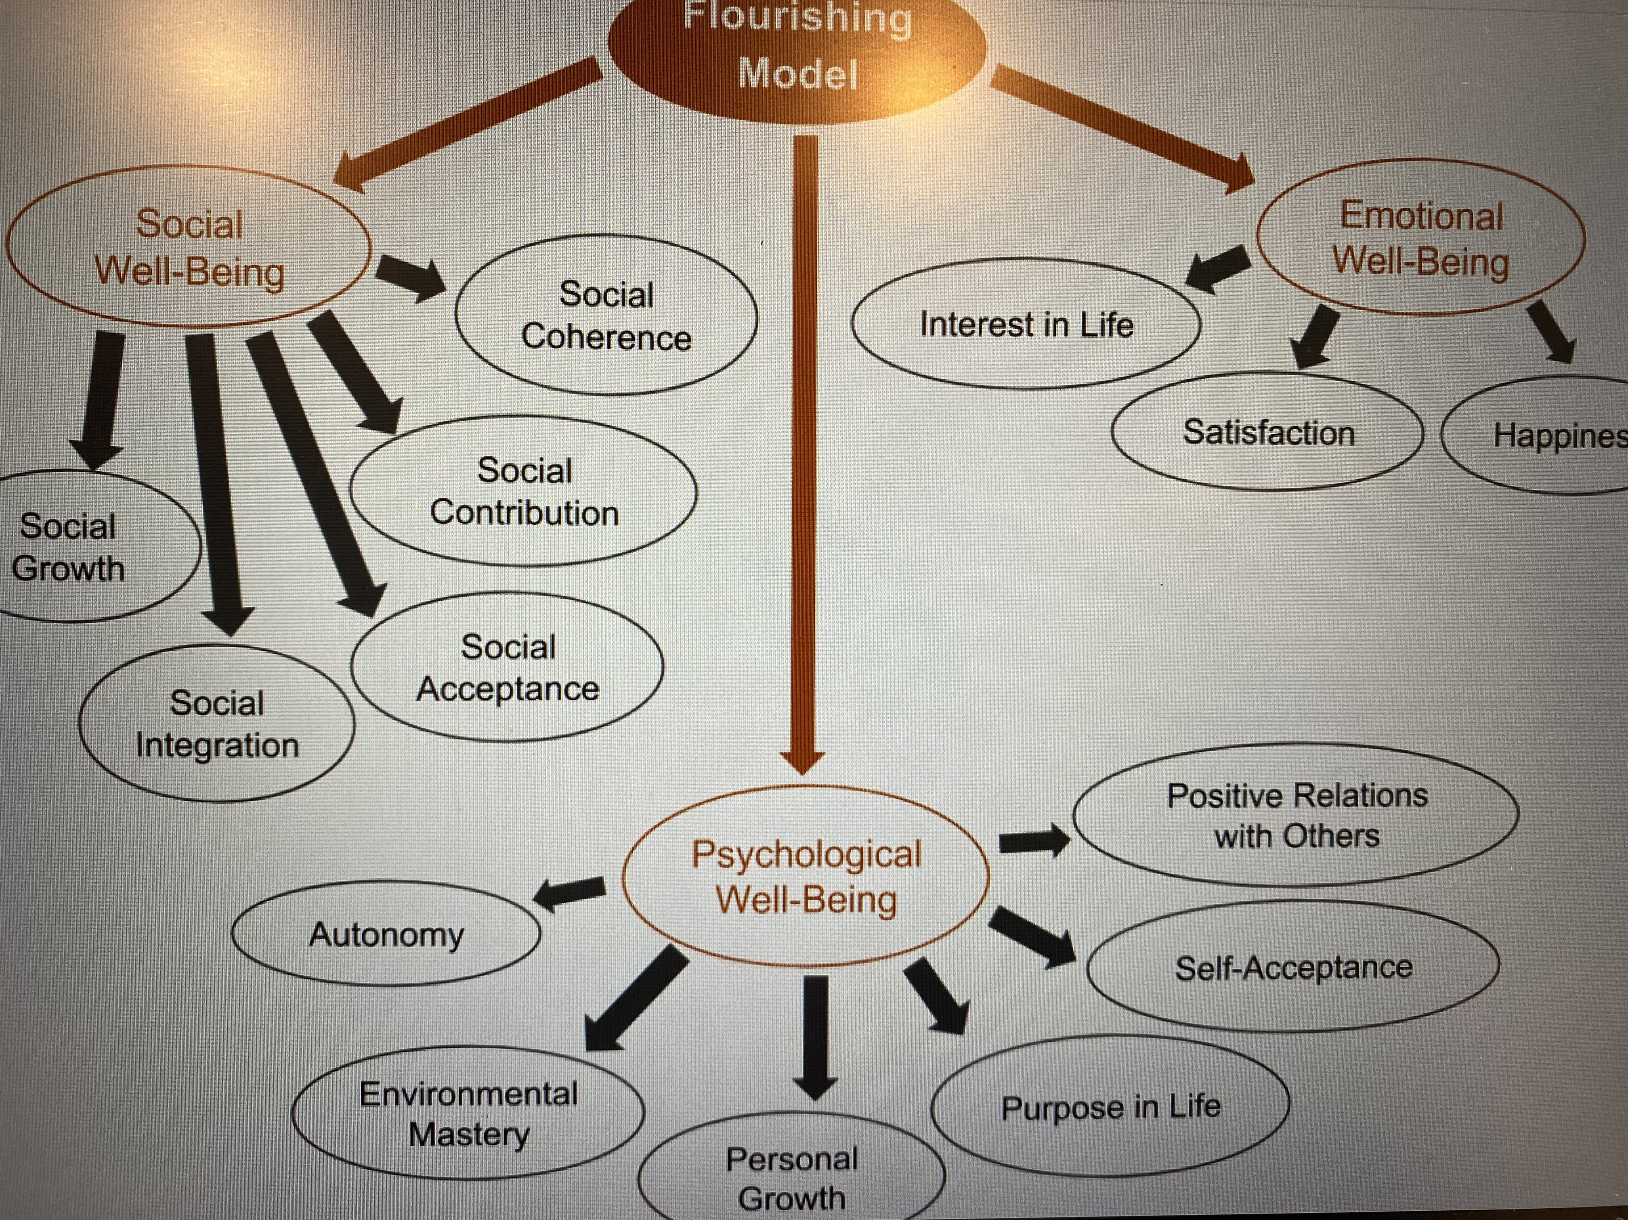

Slide 38
Positive Communities
Flourishing communities nurture social environments/promote well-being in 4 ways
Minimize biological and psychological toxic events
e.g., family abuse, poor access to healthy food
Teach prosocial and self-regulatory behaviors
Monitor and limit opportunities for problem behavior e.g., neighborhood watch
Foster psychological flexibility by allowing people to make their values explicit and to act in the service of their values
Notes:
Nurturing social environments promote well-being in four ways:
They minimize biological and psychological toxic events.
Nurturing environments teach prosocial and self-regulatory behaviors.
They monitor and limit opportunities for problem behavior.
They foster psychological flexibility by allowing people to make their values explicit and to act in the service of their values.
High and low synergy cultures: These are cultures in which many of the activities in which people engage are mutually reinforcing and enhance their general well-being. Low synergy cultures are those in which personal goals often conflict with the society’s overall well-being.
Well-being differences in many aspects: Differences in average well-being among states, counties, and regions within countries, well-being differences among cities, differences among the well-being of cultural groups.
Social capital as behavioral component: Social capital is a web of connections among social networks, as well the connections within social networks. When a society has a high level of social capital, then there is a greater sense of trust in other people, more reciprocity and helping, greater participation in social and civic activities, and stronger social ties. Social capital, therefore, has a behavioral component.

Slide 39
Positive Communities
Flourishing communities
High and low synergy cultures
Degree to which activities are mutually reinforcing among members and enhance well-being
Well-being differences in many aspects
By state, city, geographical region, country
Importance of education for well-being
Level is minor contributor to well-being, but people who live in city with more highly educated residents tend to report greater well-being
Notes:
Nurturing social environments promote well-being in four ways:
They minimize biological and psychological toxic events.
Nurturing environments teach prosocial and self-regulatory behaviors.
They monitor and limit opportunities for problem behavior.
They foster psychological flexibility by allowing people to make their values explicit and to act in the service of their values.
High and low synergy cultures: These are cultures in which many of the activities in which people engage are mutually reinforcing and enhance their general well-being. Low synergy cultures are those in which personal goals often conflict with the society’s overall well-being.
Well-being differences in many aspects: Differences in average well-being among states, counties, and regions within countries, well-being differences among cities, differences among the well-being of cultural groups.
Social capital as behavioral component: Social capital is a web of connections among social networks, as well the connections within social networks. When a society has a high level of social capital, then there is a greater sense of trust in other people, more reciprocity and helping, greater participation in social and civic activities, and stronger social ties. Social capital, therefore, has a behavioral component.

Slide 40
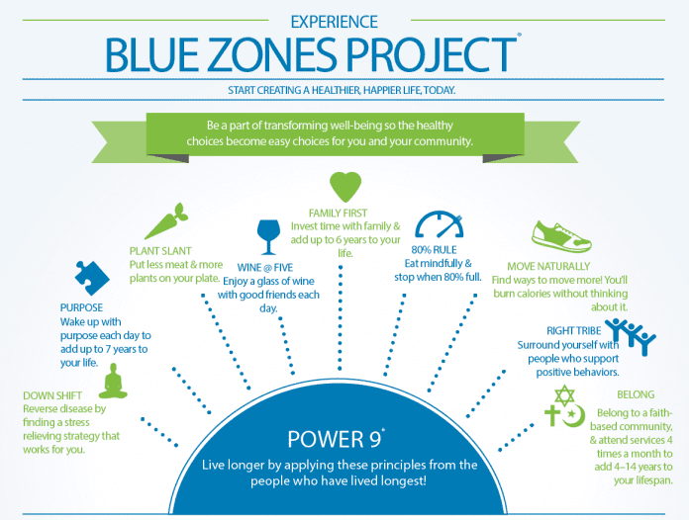
Blue Zones of Happiness (Dan Buettner)

Slide 41
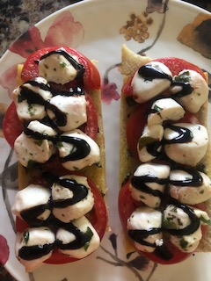



Positive Communities
Social contagion:
The power of social networks
Spreading of behaviors and emotions
e.g., the more people around you who start putting on weight, the more you will…I think the opposite is working for my family: I grow fruits and veggies and have them with every home cooked dinner
Notes:
Happiness spread throughout social networks: Each act of kindness spread throughout a social network and its impact was tripled as it spread.

Slide 42

Positive Communities
Social contagion: The power of social networks
Spreading emotions through social networks
Happiness spread throughout social networks
Cooperate behavior cascades in social networks
Smiling
Practicing random acts of kindness
Notes:
Happiness spread throughout social networks: Each act of kindness spread throughout a social network and its impact was tripled as it spread.

Slide 43
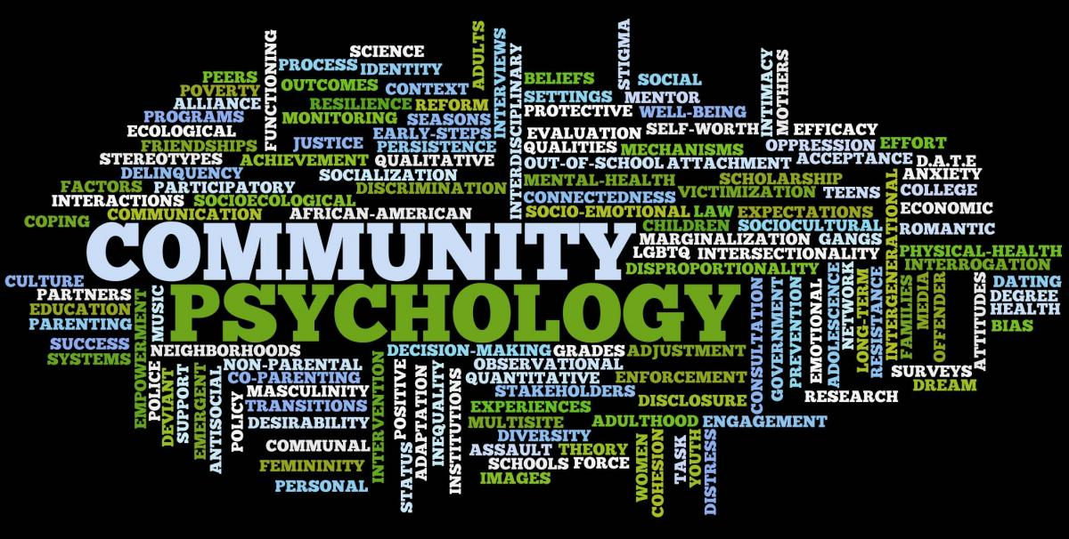
Positive Communities
Community psychology
Role of environment and social world in creation of problems and their solution
Study of the person in social context
Notes:
Three foundations of community psychology: Cultural relativity which affirms that social rules, mores, and standards may differ among different cultural groups. Diversity that affirms that in many societies, the reality of cultural diversity presents the necessity of recognizing that differences among community subgroups will continue to exist. Ecology is here applied not just to the natural environment, but also to the reality of a human ecology, that is, people exist not in isolation, but in a constant variety of intricate relationships with their environment.
Focus on competencies: Change happens by identifying the strengths, resources, and efficiencies of people and environments.

Slide 44
Positive Communities
Community psychology
Three foundations of community psychology
Cultural relativity
Affirms that social rules, mores, and standards may differ among different cultural groups
Diversity
Affirms that in many societies, the reality of cultural diversity presents the need to recognize that differences among community subgroups will continue
Ecology
Affirms that people exist in a constant interplay of intricate relationships with their environment
Notes:
Three foundations of community psychology: Cultural relativity which affirms that social rules, mores, and standards may differ among different cultural groups. Diversity that affirms that in many societies, the reality of cultural diversity presents the necessity of recognizing that differences among community subgroups will continue to exist. Ecology is here applied not just to the natural environment, but also to the reality of a human ecology, that is, people exist not in isolation, but in a constant variety of intricate relationships with their environment.
Focus on competencies: Change happens by identifying the strengths, resources, and efficiencies of people and environments.

Slide 45
Positive Communities
Community psychology: Empowerment
Enable the marginalized or underprivileged to increase personal and political power
Taking charge of their lives
Enhances efficacy and self-determination
Learned empowerment
Learn to exert a degree of control over environment
One form is collective efficacy: sense of social cohesion that creates local friendship networks and a sense of agency or willingness to intervene in making community better
Sense of trust and willingness develop
Notes:
Learned empowerment is collective efficacy: People can learn to assert a degree of control over their communities through community activity that produces tangible results. Indeed, people feel better about themselves and their communities when they believe they have a voice, are able to make changes, and can participate meaningfully in the democratic process. Collective efficacy is a sense of social cohesion in a community that creates local friendship networks, and a sense of agency or willingness to intervene in making the neighborhood a better place to live.

Slide 46
Positive Communities
Community psychology: Community interventions
Emphasis on positive interventions
Help improve personal lives and the communities
Creation of “village” movement
Elderly “village” movement
Assistance with chores, shopping, transportation
Notes:
Creation of village movement: Villages are organized networks of volunteers who offer assistance to older persons who wish to continue living in their homes. Volunteers may help with transportation needs, household repairs, or even with teaching computer skills. These small gestures can be all that’s needed for someone to remain at home and continue to enjoy a place that holds many comforts and fosters happy memories.

Slide 47
Positive Communities
Volunteerism
More engagement with communities
Rewards associated with kinds of volunteering
Reasons of volunteering
Altruism
Seek to gain knowledge and understanding
Desire to enhance self-esteem
Social pressures
Result greater if volunteer has prosocial values
Notes:
Reasons of volunteering: Altruism, seeking to gain knowledge and understanding, and a desire to enhance self-esteem and social pressures.

Slide 48
Cross-Cultural Subjective Well-Being
Culture: set of attitudes, values, beliefs, and behaviors shared by a group of people, communicated from one generation to the next
All cultures have a concept for the emotion of happiness, but differences in how it is understood, expressed, experienced
Different measures of well-being
World Database of Happiness
United Nations Human Development Indicators
Gallup World Poll
Happy Planet Index
Notes:
The Happy Planet Index: The index combines four measures:
Well-being using data from the Gallup World Poll.
Life expectancy.
Inequality of outcomes (i.e., how much difference there is between those at the top and those at the bottom of various well-being measures).
The ecological footprint.
19 values confined to four factors:
Self-transcendence which consisted of values such as caring for others, tolerance, and humility and could be considered a sacred emotions factor.
Self-directed hedonism.
Conservation or respecting tradition, obeying rules, and social conformity.
Self-enhancement or achievement and dominance.

